Slide 1
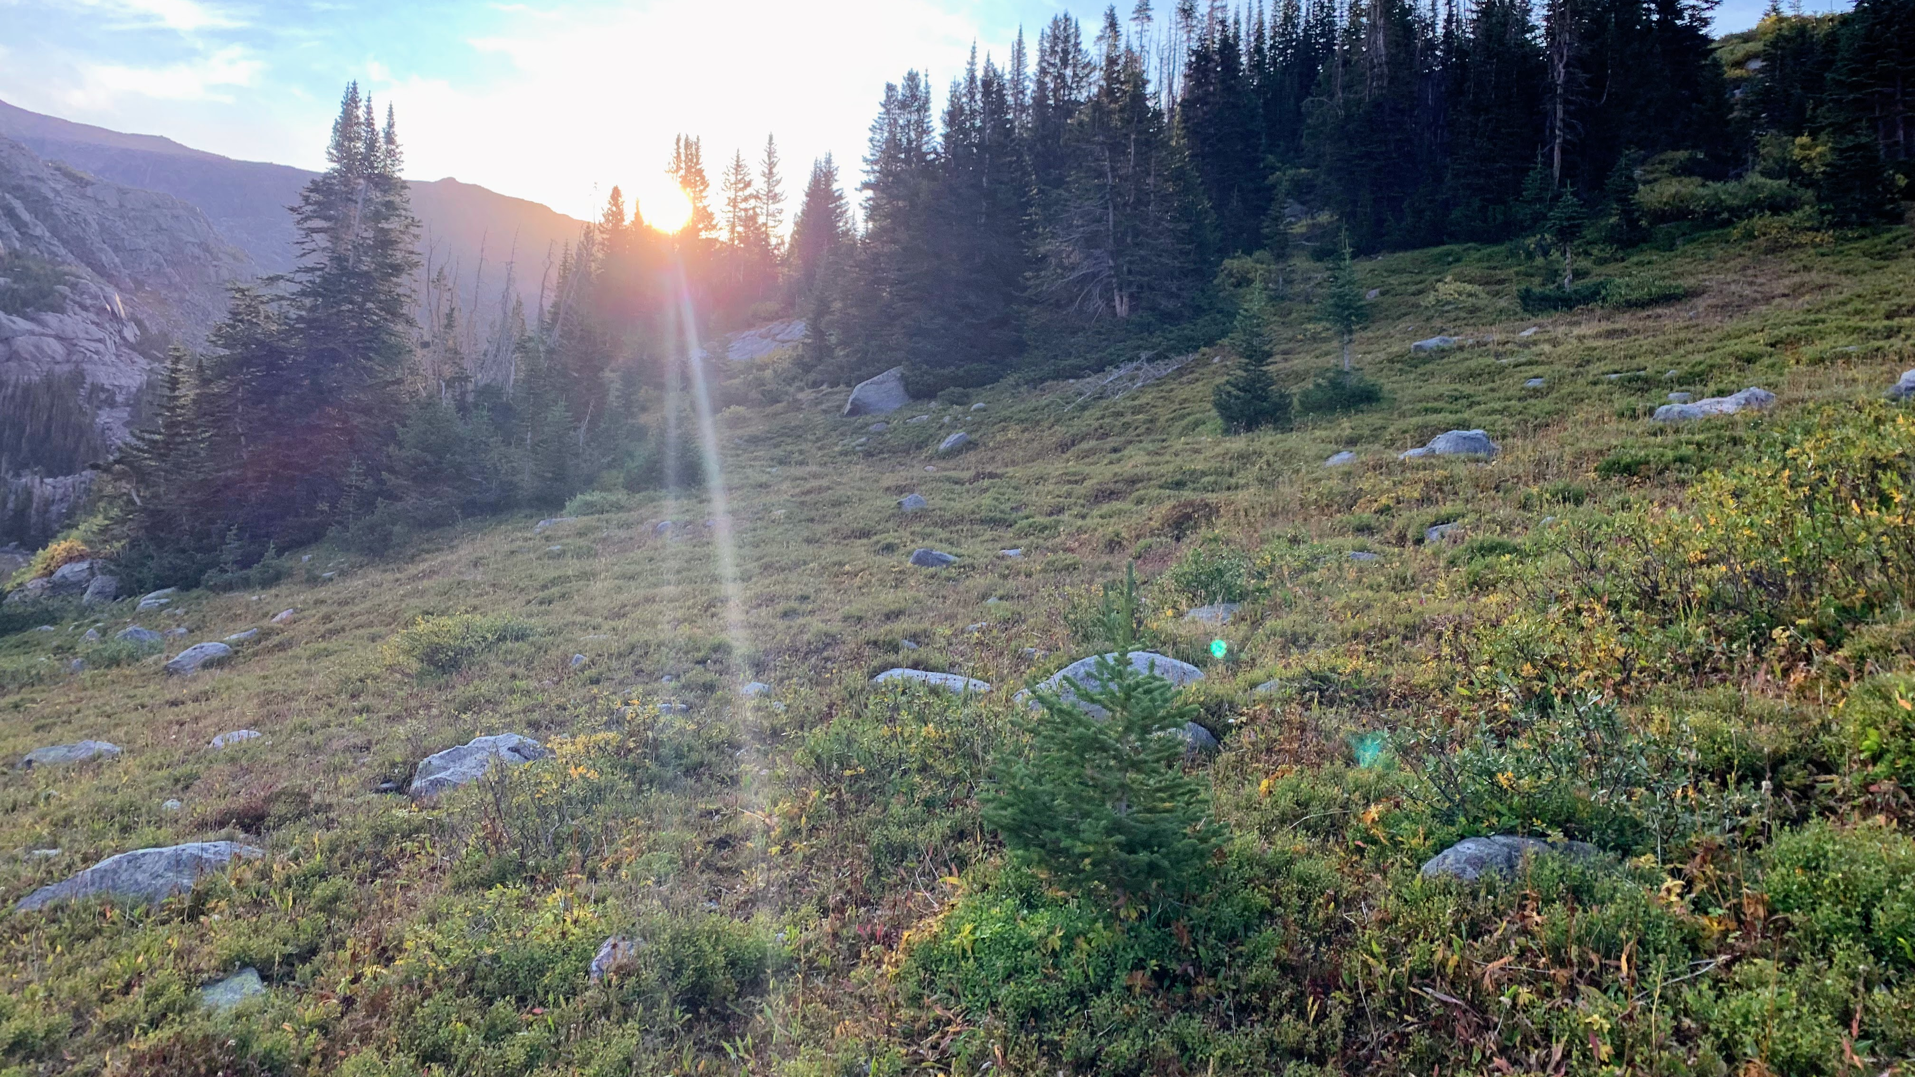
Day #3
Writing the First Draft

Slide 2
Homework
Read “Losing my Innocence” and “Henry County”
Rough draft of narrative

Slide 3
Review
Exposition: Set the scene, and show how the conflict or problem started.
Rising Action: Build tension and suspense, showing how the crisis developed or worsened.
Climax: End the suspense by dramatizing the most critical moment or turning point.
Falling Action: Show how the tension diminished as the conflict moved toward resolution.
Conclusion: Bring closure to the story, and reflect on the event’s overall significance.

Slide 4
Taking a journal paragraph to a first draft
Please watch the demonstration.

Slide 5
Journal 3
Choose one of your prompts from yesterday. What will make the most promising story? Why? Will you be able to remember what was said and how things seemed at the time? What was significant about that time? How can you make your characters real to us?

